Slide 1

Lean Six Sigma Yellow Belt Training
Featuring Examples from Minitab 18

Slide 2
1.0 Define Phase

Slide 3
1.1 Overview of Six Sigma

Slide 4
Black Belt Training: Define Phase
1.1 Six Sigma Overview
1.1.1 What is Six Sigma
1.1.2 Six Sigma History
1.1.3 Six Sigma Approach Y = f(x)
1.1.4 Six Sigma Methodology
1.1.5 Roles and Responsibilities
1.2 Six Sigma Fundamentals
1.2.1 Defining a Process
1.2.2 VOC and CTQs
1.2.3 QFD
1.2.4 Cost of Poor Quality (COPQ)
1.2.5 Pareto Analysis (80 : 20 rule)
1.3 Lean Six Sigma Projects
1.3.1 Six Sigma Metrics
1.3.2 Business Case and Charter
1.3.3 Project Team Selection
1.3.4 Project Risk Management
1.3.5 Project Planning
1.4 Lean Fundamentals
1.4.1 Lean and Six Sigma
1.4.2 History of Lean
1.4.3 The Seven Deadly Muda
1.4.4 Five-S (5S)

Slide 5
1.1.1 What is Six Sigma

Slide 6
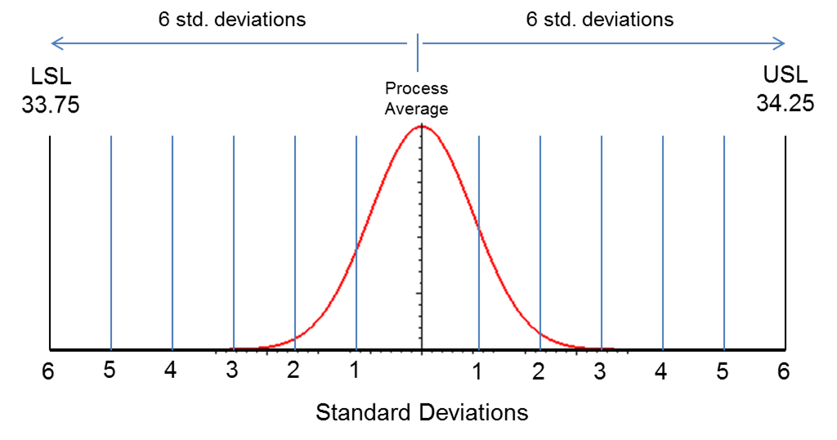
What is Six Sigma?
What is “sigma”?
  In statistics, sigma (σ) refers to “standard deviation,” which is a measure of variation.
  You will come to learn that variation is the enemy of any quality process. We need to understand, manage, and minimize process variation.
What is “Six Sigma”?
  Six Sigma is an aspiration or goal of process performance.
  A Six Sigma “goal” is for a process average to operate approximately 6σ away from customer’s high and low specification limits.
Notes:
Most people think of Six Sigma as a disciplined, data-driven approach to eliminating defects and solving business problems.
If you break down the two words, “Six Sigma,” they really describe a measure of quality that strives for near perfection.
Sigma and standard deviation are the same thing, a measure of variation.
Variation is the enemy of quality; it makes it much more difficult to meet a customer’s expectation for a product or service.
The aspiration is to limit the variation to such a degree that 6 “sigmas” (or standard deviations) above or below your mean will fall within the limits that are acceptable to customers.

Slide 7
What is Six Sigma?
A process whose average is about 6σ away from the customer’s high and low specification limits has abundant room to “float” before approaching the customer’s specification limits.
A Six Sigma process only yields 3.4 defects for every million opportunities! In other words, 99.9997% of the products are defect-free!
Notes:
The more variation that can be reduced in the process (by narrowing the distribution), the more easily the customer’s expectations can be met.
A Six Sigma process will yield only 3.4 defects for every million opportunities, but some processes require more quality and some require less.
It is important to note that a Six Sigma level of quality does not come without cost, so one must consider what level of quality is needed or acceptable and how much can be spent on resources to remove the variation.

Slide 8
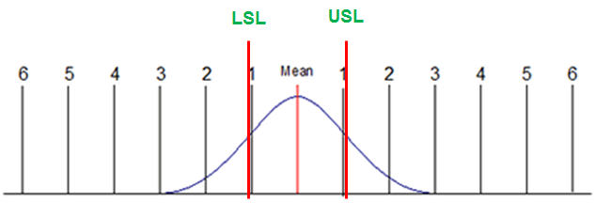
What is Six Sigma: Sigma Level
Sigma level measures how many “sigma” there are between your process average and the nearest customer specification.
Let us assume that your customers upper and lower specifications limits (USL & LSL) were narrower than the width of your process spread.
The USL & LSL below stay about 1 standard deviation away from the process average. Therefore, this process operates at 1 sigma.
Notes:
On the previous page, the LSL and USL were at 6 standard deviations from the mean. Would that process be more or less forgiving than the one that is pictured?
This process is much less forgiving. It is a 1 sigma process because the USL and LSL are only 1 standard deviations from the mean.
The area under the blue curve to the left of the LSL and to the right of the USL represents process defects.

Slide 9

What is Six Sigma: Sigma Level
A process operating at 1 sigma has a defect rate of approximately 70%.
          This means that the process will generate defect-free products only 30% of the time.
What about processes with more than 1 sigma level?
A higher sigma level means a lower defect rate.
Let us take a look at the defect rates of processes at different sigma levels.
Notes:
A 1 sigma process will generate defects 70% of the time, so for every 3 units that are good, there are 7 defective.
A 1 sigma process is not desirable anywhere. What are the implications of such a process? High customer claims, high process waste, lost reputation…any others?

Slide 10
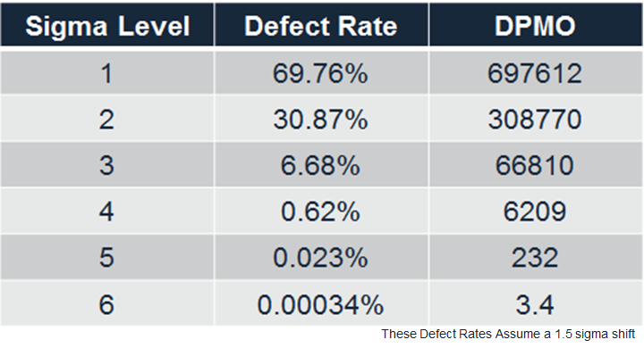
What is Six Sigma: Sigma Level
This table shows each sigma level’s corresponding defect rate and DPMO (defects per million opportunities).
The higher the sigma level, the lower the defective rate and DPMO.
How does this translate into things you might easily relate to?
Notes:
The table on this page shows how dramatically the quality can improve when moving from a 1 sigma process, to 2 sigma, to 3, and so on.
On the next page we will look at how this concept applies to some everyday applications.

Slide 11
What is Six Sigma: Sigma Level
Let us take a look at processes operating at 3 sigma.
3 sigma processes have a defect rate of approximately 7%. What would happen if processes operated at 3 sigma?
  Virtually no modern computer would function*.
  10,800,000 health care claims would be mishandled each year.
  18,900 US savings bonds would be lost every month.
  54,000 checks would be lost each night by a single large bank.
  4,050 invoices would be sent out incorrectly each month by a modest-sized telecommunications company.
  540,000 erroneous call details would be recorded each day from a regional telecommunications company.
  270 million erroneous credit card transactions would be recorded each year in the United States.
(*http://www.qualityamerica.com)
Notes:
Can you imagine what a 3 sigma process would look like in the tech industry, in health care, in banking?
Can you apply this concept to a process that you relate to?

Slide 12
What is Six Sigma: Sigma Level
What if processes operated with 1% defect rate?
  20,000 lost articles of mail per hour*.
  Unsafe drinking water almost 15 minutes per day.
  5,000 incorrect surgical operations per week.
  Short or long landings at most major airports each day.
  200,000 wrong drug prescriptions each year.
  No electricity for almost 7 hours per month.
Even at 1% defect rate, some processes would be unacceptable to you and many others.
So what is Six Sigma?
  Sigma level is the measure!
  Six is the goal!
(* Implementing Six Sigma – Forest W. Breyfogle III)

Slide 13
What is Six Sigma: The Methodology
Six Sigma itself is the goal, not the method.
In order to achieve Six Sigma, you need to improve your process performance by:
  Minimizing the process variation so that your process has enough room to fluctuate within customer’s spec limits
  Shifting your process average so that it is centered between your customer’s spec limits.
Accomplishing these two process improvements (along with stabilization and control), you can achieve Six Sigma.
DMAIC is the systematic methodology prescribed to achieve Six Sigma.
Notes:
While Six Sigma is often associated with the methodology, it is actually the goal.
To achieve the goal, process performance must be achieved by reducing the variation and/or shifting the process average.
By doing this, the process is more capable of meeting the specification limits that are set by the customer.
Stabilization and control refer to the ability to maintain the process improvements or level of quality over time.
The methodology that should be used to achieve the goal is called DMAIC.

Slide 14
What is Six Sigma: The Methodology
DMAIC is a systematic and rigorous methodology that can be applied to any process in order to achieve Six Sigma.
It consists of 5 phases of a project:
  Define
  Measure
  Analyze
  Improve
  Control.
You will be heavily exposed to many concepts, tools, and examples of the DMAIC methodology through this training.
You will be capable of applying the DMAIC methodology to improve the performance of any process at the completion of the curriculum.
Notes:
DMAIC is the path to Six Sigma. It is a disciplined, rigorous, data-driven approach that can be applied to any process.
The phases are DEFINE, MEASURE, IMPROVE, ANALYZE, and CONTROL.
The goal of this training is to teach you how to apply DMAIC and leverage the many concepts and tools within it.

Slide 15
1.1.2 Six Sigma History

Slide 16
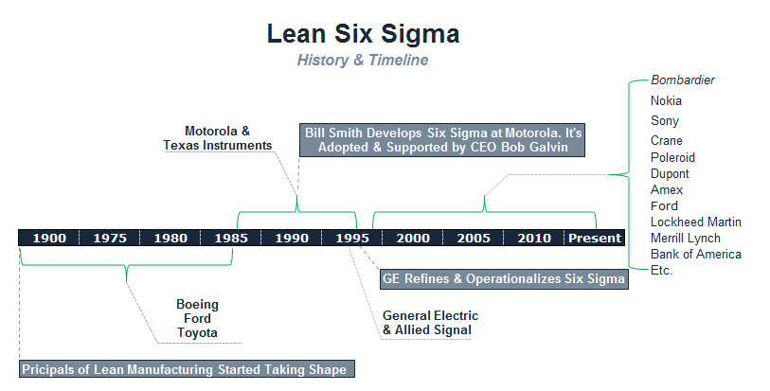
Six Sigma History
Polaroid
Notes:
Six Sigma was originally developed by Motorola in 1986, but really became popular when Jack Welch at GE made it the focus of his business strategy. Since the late 90s, it has become widely used across many industries. Maybe you have heard of a few of these?
While the term “Lean” was coined in the 1990s, the methodology is mainly based on the concepts of the Toyota Production System, which was developed by Taiichi Ohno, Shigeo Shingo, and Eiji Toyoda at Toyota between 1948 and 1975.

Slide 17
Six Sigma History
The “Six Sigma” terminology was originally adopted by Bill Smith at Motorola in the late 1980s as a quality management methodology.
As the “Father of Six Sigma,” Bill forged the path for Six Sigma through Motorola’s CEO Bob Galvin who strongly supported Bill’s passion and efforts.
Starting from the late 1980s, Motorola extensively applied Six Sigma as a process management discipline throughout the company, leveraging Motorola University.
In 1988, Motorola was recognized with the prestigious Malcolm Baldrige National Quality Award for its achievements in quality improvement.
Notes:
Bill Smith originally approached Bob Galvin with what he referred to as the “theory of latent defect.”
The core principle of the theory is that variation in manufacturing processes is the main driver for defects, and eliminating variation will help eliminate defects. In turn, it will eliminate the wastes associated with defects, saving money and increasing customer satisfaction.
The threshold agreed to by Motorola was 3.4 defects per million opportunities…does it sound familiar?

Slide 18
Six Sigma History
Six Sigma has been widely adopted by companies as an efficient way of improving the business performance since General Electric implemented the methodology under the leadership of Jack Welch in the 1990s.
As GE connected Six Sigma results to its executive compensation and published the financial benefits of Six Sigma implementation in their annual report, Six Sigma became a highly sought-after discipline of quality.
Notes:
In the 1990s, Six Sigma became widely popular after it was implemented at GE under the leadership of Jack Welch.
Companies across many industries followed suit. In some cases GE taught companies how to deploy the methodology, and in many cases experts from GE and other pioneer companies were heavily recruited to companies that were new to methodology.

Slide 19
Six Sigma History
Most Six Sigma programs cover the aspects, tools, and topics of Lean or Lean Manufacturing.
The two work hand in hand, benefitting each other.
  Six Sigma focuses on minimizing process variability, shifting the process average, and delivering within customer’s specification limits.
  Lean focuses on eliminating waste and increasing efficiency.
Lean and its popularity began to form and gain significant traction in the mid 1960s with the Toyota initiative “TPS” or Toyota Production System.
The concepts and methodology of Lean, however, were fundamentally applied much earlier by both Ford and Boeing in the early 1900s.
Notes:
The DMAIC methodology is essentially an ordered collection of concepts and tools that were not unique to Six Sigma. The concepts and tools are leveraged in a way that leads down a problem solving path.
Another methodology that is complementary to Six Sigma is Lean or Lean Manufacturing.
While Six Sigma focuses on process variability, Lean focuses on eliminating waste and improving process flow and efficiency.
Although the concepts have been applied all the way back in the early 1900s by Ford and Boeing, they were made popular by Toyota in the 1960s with what was originally known as the “just-in-time production system,” and became known as the Toyota Production System.

Slide 20
Six Sigma History
Despite the criticism and immaturity of Six Sigma in many aspects, its history continues to be written with every company and organization striving to improve its business performance.
Polaroid
Notes:
The track record for many of these companies, after implementing Six Sigma, speaks for itself.

Slide 21
1.1.3 Six Sigma Approach

Slide 22
Six Sigma Approach: Y = f(x)
The Six Sigma approach to problem solving uses a transfer function.
A transfer function is a mathematical expression of the relationship between the inputs and outputs of a system.
Y = f(x) is the relational transfer function that is used by all Six Sigma practitioners.
It is absolutely critical that you understand and embrace this concept.

Slide 23
Six Sigma Approach: Y = f(x)
“Y” refers to the measure or output of a process.
  Y is usually your primary metric
  Y is the measure of process performance that you are trying to improve.
f(x) means “function of x.”
  x’s are factors or inputs that affect the Y
Combined, the Y = f(x) statement reads “Y is a function of x.”
In simple terms: “My process performance is dependent on certain x’s.”
The objective in a Six Sigma project is to identify the critical x’s that have the most influence on the output (Y) and adjust them so that the Y improves.
Notes:
You might have been introduced to the transfer function in middle school algebra, but it means so much more than symbolizing an algebraic equation.
It is important to keep in mind this concept throughout the DMAIC process. The system (or process) outputs (Y’s) are a function of the inputs (x’s).

Slide 24
Six Sigma Approach: Y = f(x)
Let us look at a simple example of a pizza delivery company that desires to meet customer expectations of on-time delivery.
  Measure = on-time pizza deliveries
    Y = percent of on-time deliveries
  f(x) would be the x’s or factors that heavily influence timely deliveries
    x1: might be traffic
    x2: might be the number of deliveries per driver dispatch
    x3: might be the accuracy of directions provided to the driver
    x4: might be the reliability of the delivery vehicle
    etc.
The statement Y = f(x) in this example will refer to the proven x’s determined through the steps of a Six Sigma project.
Notes:
Most would agree that an important requirement of pizza delivery is to be fast or “on-time.” In this example, let us consider factors that might cause variation in Y (percent of on-time deliveries).
In the DMAIC process, the goal is to determine which inputs (x’s) are the main drivers for the variation in Y.

Slide 25

Six Sigma Approach: Y = f(x)
X₃
X₂
With this approach, all potential x’s are evaluated throughout the DMAIC methodology.
The x’s should be narrowed down until the vital few x’s that significantly influence “on-time pizza deliveries” are identified!
X₇
X₄
X₅
X₈
X₁
X₆
Y=f(x)
Notes:
One might think of the DMAIC process as a funnel to narrow down all the possible x’s to the vital few.
Why might it be important to know what the vital few x’s are? To focus improvement where the most impact can be affected through changing the inputs.

Slide 26
Six Sigma Approach: Y = f(x)
This approach to problem solving will take you through the process of determining all potential x’s that might influence on-time deliveries and then determining through measurements and analysis which x’s do influence on-time deliveries.
Those significant x’s become the ones used in the Y = f(x) equation.
The Y = f(x) equation is a very powerful concept and requires the ability to measure your output and quantify your inputs.
Measuring process inputs and outputs is crucial to effectively determining the significant influences to any process.
Notes:
The approach will funnel the possible x’s to the few that do influence Y. The measurement of those x’s and their effect on the Y then become the focus to determine which have the most significant impact.
By determining which have the most impact, resources can be focused on changing those inputs to achieve the desired process output.

Slide 27
1.1.4 Six Sigma Methodology

Slide 28
Six Sigma Methodology
Six Sigma follows a methodology that is conceptually rooted in the principles of a five-phase project.
Each phase has a specific purpose and specific tools and techniques that aid in achieving the phase objectives.
The 5 phases of DMAIC:
  Define
  Measure
  Analyze
  Improve
  Control
Notes:
Six Sigma is a data-driven methodology for solving problems, improving, and optimizing business problems.
It has 5 phases, each with a specific and important purpose toward achieving the goal of the project.

Slide 29
Six Sigma Methodology
Define
Define and quantify the problem and objective
Measure
Baseline process, validate measures, and identify all possible x’s and dependent Y’s
Analyze
Analyze and validate causes identifying critical factors
Improve
Control
Develop solutions
Implement and sustain solutions
Notes:
DEFINE – the main goal is to “define” what the project is setting out to do and scope the effort.
MEASURE – To establish a baseline for the process, ensure the measurement system is reliable, and identify all possible root causes for a problem.
ANALYZE – To narrow down all possible root causes to the critical few that are the primary drivers of the problem.
IMPROVE – To develop the improvements for the process.
CONTROL – To implement the fix and a control plan to ensure the improvements are sustained over time.
In terms of the transfer function:
DEFINE – Understand the project Y’s and how to measure them.
MEASURE – Prioritize potential x’s and measure x’s and Y’s.
ANALYZE – Test x-Y relationships and verify/quantify important x’s.
IMPROVE – Implement solutions to improve Y’s and address important x’s.
CONTROL – Monitor important x’s and the Y’s over time.

Slide 30
Six Sigma Methodology: Define Phase
The goal of the Define phase is to establish a solid foundation and business case for a Six Sigma project.
Define is arguably the most important aspect of any Six Sigma project.
All successful projects start with a current state challenge or problem that can be articulated in a quantifiable manner.
  It is not enough to just know the problem, you must quantify it and also determine the goal.
Once problems and goals are identified and quantified, the rest of the define phase will be about valuation, team, scope, project planning, timeline, stakeholders, Voice Of the Customer (VOC), and Voice Of the Business (VOB).
Notes:
DEFINE is a critical phase. It sets the foundation for the project, and if it is not done well and properly thought, it is very easy for a project to go off-track.
All problems start with a quantifiable problem statement – without a baseline and a goal, it is very difficult to keep boundaries around the project. Without knowing how much improvement is needed or desired, it can be very difficult to control the scope of the project.

Slide 31
Six Sigma Methodology: Define Phase
Define Phase Tools and Deliverables
  Project Charter – Establish the:
      Business Case
      Problem Statement
      Project Objective
      Project Scope
      Project Timeline
      Project Team.
  Stakeholder Assessment
  High-Level Pareto Chart Analysis
  High-Level Process Map
  VOC/VOB and CTQs Identified and Defined
  Financial Assessment
Notes:
The project charter is essentially a contract formed between a project team, the champion, and the stakeholders. It defines what the project is going to do, why they are going to do it, when it will be done, and by whom. It includes the business case, problem statement, project objective, scope, timeline, and team.
A stakeholder assessment is done to understand where there are gaps in stakeholder support and develop strategies to overcome them.
High-level Pareto chart and process maps, along with VOC (voice of customer), VOB (voice of business), and CTQs (critical to quality requirements) also help to develop the scope and put some guardrails around the process.

Slide 32
Six Sigma Methodology: Measure Phase
The goal of the Measure phase is to gather baseline information about the process (process performance, inputs, measurements, customer expectations etc.).
Throughout the Measure phase you will seek to achieve a few important objectives:
  Gather All Possible x's
  Assess Measurement System and Data Collection Requirements
  Validate Assumptions
  Validate Improvement Goals
  Determine COPQ (Cost of Poor Quality)
  Refine Process Understanding
  Determine Process Stability
  Determine Process Capability.
Notes:
The MEASURE phase is necessary to establish the baseline performance for the process, determine if the measurement system(s) is (are) reliable. It is also important to determine if the process is stable and how capable the process is of meeting the customer’s specifications.
There are a few important objectives: identify all the possible x’s, plan what data needs to be collected, assess measurement systems for reliability, validate assumptions and improvement goals, determine the Cost of Poor Quality (COPQ), determine if the process is stable and if the process is capable of meeting customer requirements.

Slide 33
Six Sigma Methodology: Measure Phase
Measure Phase Tools and Deliverables
  Process Maps, SIPOC, Value Stream Maps
  Failure Modes and Effects Analysis (FMEA)
  Cause-and-Effect Diagram
  XY Matrix
  Six Sigma Statistics
    Basic Statistics
    Descriptive Statistics
  Measurement Systems Analysis
    Variable and/or Attribute Gage R&R
    Gage Linearity and Accuracy or Stability
  Basic Control Charts
  Process Capability (Cpk, Ppk) and Sigma Levels
  Data Collection Plan
Notes:
There are many powerful tools that will be introduced to you throughout the MEASURE phase.
There are many different types of maps to visualize a process:
A SIPOC or a Value Stream Map
An FMEA (Failure Modes and Effects Analysis) to identify possible process failure modes and prioritize them
Tools to brainstorm possible root causes for defects (Cause and Effect) and prioritize those (XY matrix)
Some basic statistical tools to understand more about your process data (Basic and Descriptive Statistics)
Measurement system analysis tools to establish repeatability, reproducibility, linearity, accuracy, and stability
Basic control charts to assess process stability
Tools to assess and quantify a process’ ability to meet customer specification limits
A data collection plan to ensure that when data is collected, it is done properly.

Slide 34
Six Sigma Methodology: Analyze Phase
The Analyze phase is all about establishing verified drivers.
In the DMAIC methodology, the Analyze phase uses statistics and higher-order analytics to discover relationships between process performance and process inputs (in other words, what are the root causes or drivers of the improvement effort).
Ultimately, the Analyze phase establishes a reliable hypothesis for improvement solutions.
  Establish the Transfer Function Y = f(x)
  Validate the List of Critical x's and Impacts
  Create a Beta Improvement Plan (e.g., pilot plan).
Notes:
The ANALYZE phase is where the potential root causes are narrowed down to the critical root causes.
Statistical tools are used to determine whether or not there are relationships between process performance and the potential root causes.
Where the strong relationships are discovered, these become the foundation for the solution to improve the process.
This is where the transfer function, Y = f(x), is established and the project can establish a hypothesis for improved results.

Slide 35
Six Sigma Methodology: Analyze Phase
Analyze Phase Tools and Deliverables
  The Analyze phase is about proving and validating critical x’s using the appropriate and necessary analysis techniques. Examples include:
    Hypothesis Testing
      Parametric and Non-Parametric
    Regression
      Simple Linear Regression
      Multiple Linear Regression
  The Analyze phase is also about establishing a set of solution hypotheses to be tested and further validated in the Improve phase.
Notes:
There are many tools that are used to prove and validate the critical x’s:
Hypothesis tests such as t-tests, ANOVA, Chi-Square, to name a few
Different types of regression to establish quantitative and predictive relationships between the x’s and Y’s
The tools help to formulate a hypothesis about how much improvement can be expected in the Y, given a change in the x.

Slide 36
Six Sigma Methodology: Improve Phase
The goal of the Improve phase is. . .you guessed it! "make the improvement." Improve is about designing, testing, and implementing your solution.
To this point you have defined the problem and objective of the project, brainstormed possible x's, analyzed and verified critical x's. Now it's time to make it real!
  Statistically Proven Results from Active Study/Pilot
  Improvement/Implementation Plan
  Updated Stakeholder Assessment
  Revised Business Case with Return on Investment (ROI)
  Risk Assessment/Updated FMEA
  New Process Capability and Sigma.
Notes:
Methodologies for the IMPROVE phase include:
Experiments and planned studies
Pilots or tests designed to validate relationships and determine how much change in an input is needed to induce the desired result in the output.
Implementation plan to stimulate thoughts and planning for any necessary communications, training, and preparations to implement the process improvement

Slide 37
Six Sigma Methodology: Improve Phase
Improve Phase Tools and Deliverables
  Any Appropriate Tool from Previous Phases
  Design of Experiment (DOE)
    Full Factorial
    Fractional Factorial
  Pilot or Planned Study Using:
    Hypothesis Testing
    Valid Measurement Systems
  Implementation Plan
Notes:
Other important and less often discussed elements of the IMPROVE phase are extensions of other tools introduced in earlier phases:
An updated stakeholder assessment to ensure the right support exists to make the process change.
An updated business case to justify the change.
An updated FMEA to ensure the solution is robust and proper control points are identified.
A revisited process capability and sigma level to quantify how well the improved process will perform against customer specifications.

Slide 38
Six Sigma Methodology: Control Phase
The last of the 5 core phases of the DMAIC methodology is the Control phase.
The goal of the Control phase is to establish automated and managed mechanisms to maintain and sustain your improvement.
A successful control plan also establishes a reaction and mitigation plan as well as an accountability structure.
Notes:
The CONTROL phase is a common failure point for projects.
Improvements are made, but gains will only be temporary if the proper controls are not in place.
The purpose of the CONTROL phase is to establish the mechanisms to ensure the process sustains improved performance and a reaction/mitigation plan to activate by a process owner if it does not.

Slide 39
Six Sigma Methodology: Control Phase
Control Phase Tools and Deliverables
  Statistical Process Control (SPC/Control Charts)
    IMR, XbarS, XbarR, P, NP, U, C etc.
  Control Plan Documents
    Control Plan
    Training Plan
    Communication Plan
    Audit Checklist
  Lean Control Methods
    Poka-Yoke
    Five-S
    Kanban
Notes:
Control charts are useful for monitoring process inputs and outputs for stability and quickly identifying when the process goes “out of control.”
Control plans are used to ensure control points are identified and accountability for monitoring them is taken.
A training plan is needed to ensure employees are properly trained to perform process changes.
A communication plan is useful to alert any stakeholders of a change.
Lean tools can be used to “poka-yoke” (mistake proof) a process.
Five-S can be used to organize the workplace and make it more visual.

Slide 40
Six Sigma Methodology
Six Sigma DMAIC Roadmap
Define
Goal: Problem Statement, Objective, Business Case, Project Scope, Team
Main Tools: Project Charter, Pareto, Process Maps
Measure
Goal: Brainstorm/Prioritize Possible x’s, Validate measurement, Capability
Tools: Basic Statistics, C & E, XY Matrix, Capability Analysis, MSA, Process Maps, Control Charts
Analyze
Goal: Identify critical x’s
Goal: Lock-in the Improvement
Improve
Control
Tools: Hypotheses Tests (Normal/Non Normal), Regression and Correlation
Goal: Design, Test, and Implement Improvement
Tools: DOE, Implementation/Change/Communication Plan
Tools: Control Plan, Poka-Yoke, SPC, SOPs, Training Plans etc.
Notes:
This slide provides a high-level view of the DMAIC phases and basic tools. It can be turned into a nice wall-chart or placemat to jog your memory.

Slide 41
1.1.5 Roles and Responsibilities

Slide 42
Roles and Responsibilities
The various roles in a Six Sigma program are commonly referred to as “Belts.”
In addition to Belts, there are also other key roles with specific responsibilities.
Let us explore the different roles and their corresponding responsibilities in a Six Sigma program.
Notes:
It is important to know the many roles in Six Sigma to understand where responsibilities lie to execute a project.
Most commonly known are Belts (Black Belt, Green Belt, Master Black Belt, and Yellow Belt).
There are other roles as well, such as Champion, Sponsor, and Stakeholder.

Slide 43
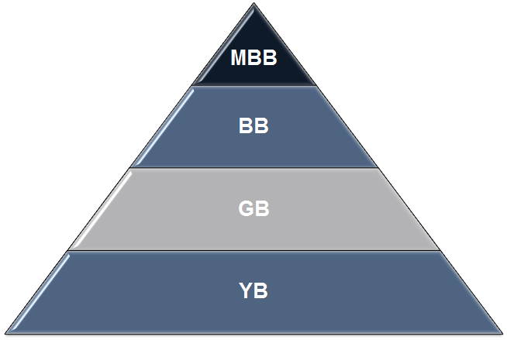
Roles and Responsibilities
Each of the four Six Sigma belts represents a different level of expertise in the field of Six Sigma.
  Six Sigma Master Black Belt (MBB)
  Six Sigma Black Belt (BB)
  Six Sigma Green Belt (GB)
  Six Sigma Yellow Belt (YB)
In addition to Belts, there are other critical and complementary roles:
  Champions
  Sponsors
  Stakeholders
  Subject Matter Experts (SMEs).
Expert
Novice
Notes:
Different Belt levels are associated with differing levels of expertise in Six Sigma, with Master Black Belt being the most highly trained expert, to Yellow belt having very basic knowledge.
There are also other roles that are very important to the success of Six Sigma initiatives, such as Champions, Sponsors, Stakeholders, and Subject Matter Experts.

Slide 44
Roles and Responsibilities: MBB
The Master Black Belt (MBB) is the most experienced, educated, and capable Six Sigma expert.
A typical MBB has managed dozens of Black Belt level projects.
The MBB can simultaneously lead multiple Six Sigma Belt projects while mentoring and certifying Black Belt and Green Belt candidates.
The MBB typically works with high-level operations directors, senior executives, and business managers to help with assessing and planning business strategies and tactics.
Notes:
The MBB is often thought of as a trusted advisor to high-level leaders.
The MBB often guides or coaches Black Belts and Green Belts and ensures the proper and consistent application of Six Sigma across departments.
While an MBB is typically technically savvy with all of the concepts and tools, it is critical that he or she has the skills to communicate in a practical manner with those that are not well-versed in Six Sigma.
Also, the MBB needs to have a strong ability to communicate with and influence leaders at all levels of an organization.

Slide 45
Roles and Responsibilities: MBB
MBB commonly advises management team on the cost of poor quality of an operation and consults on methods to improve business performance.
Typical Responsibilities of a MBB
  Identifies and defines the portfolio of projects required to support a business strategy
  Establishes scope, goals, timelines, and milestones
  Assigns and marshals resources
  Trains and mentors Green Belts and Black Belts
  Facilitates tollgates or checkpoints for Belt candidates
  Reports-out/updates stakeholders and executives
  Establishes organization’s Six Sigma strategy/roadmap
  Leads the implementation of Six Sigma.
Notes:
A MBB often is a trusted advisor to senior leaders in an organization, articulating the cost of poor quality and consulting with them about how to go about improving performance.
A MBB is responsible for defining a project portfolio to solve the businesses problems and drive the strategy.
He or she shapes the work by establishing scope, goals, and timelines.
He or she gathers resources, trains Belts, facilitates tollgates, and reports out to stakeholders and executives.
Finally, the MBB establishes a strategy for Six Sigma implementation and leads the way.

Slide 46
Roles and Responsibilities: BB
The Black Belt (BB) is the most active and valuable experienced Six Sigma professional among all the Six Sigma Belts.
A typical BB has
  led multiple projects
  trained and mentored various Green Belts candidates
  understood how to define a problem and drive effective solution.
The BB is well rounded in terms of project management, statistical analysis, financial analysis, meeting facilitation, prioritization, and a range of other value-added capabilities, which makes a BB highly valuable asset in the business world.
Notes:
The Black Belt is the key to success among all the other Belts.
The role of a Black Belt is to lead multiple projects, train and mentor Green Belts, define a problem, and drive change effectively.
The Black Belt incorporates many skills that are critical to successfully and quickly implementing a process improvement initiative through the DMAIC methodology.

Slide 47
Roles and Responsibilities: BB
BBs commonly serve as the dedicated resource continuing their line management role while simultaneously achieving a BB certification.
Typical Responsibilities of a BB
  Project Management
    Defines projects, scope, teams etc.
    Marshals resources
    Establishes goals, timelines, and milestones
    Provides reports and/or updates to stakeholders and executives.
Notes:
Often Black Belts are dedicated to improvement efforts, but typically pursue certification while simultaneously performing their normal line role.
Responsibilities include project definition, resource gathering, planning, and reporting outs.

Slide 48
Roles and Responsibilities: BB
Typical Responsibilities of a BB (continued)
  Task Management
    Establishes the team’s Lean Sigma roadmap
    Plans and implements the use of Lean Sigma tools
    Facilitates project meetings
    Does project management of the team’s work
    Manages progress toward objectives.
  Team Management
    Chooses or recommend team members
    Defines ground rules for the project team
    Coaches, mentors, and directs project team
    Coaches other Six Sigma Belts
    Manages the team’s organizational interfaces.
Notes:
The BB typically performs the role of a project manager, planning the project, facilitating project meetings, and managing toward objectives.
The BB plays a key role in forming, directing, mentoring, and coaching the team.

Slide 49
Roles and Responsibilities: GB
The Green Belt (GB) is considered as a less intense version of Six Sigma professional than the Black Belt (BB).
A GB is exposed to all the comprehensive aspects of Six Sigma with less focus on the statistical theories and some other advanced analytical methodologies such as Design of Experiment (DOE).
When it comes to project management, a GB has almost the same responsibilities as a BB.
In general, the GB works on less complicated and challenging business problems than a BB.
Notes:
While a Black Belt’s sole business responsibility could be the implementation of projects, Green Belts often implement projects in addition to other job responsibilities. Therefore, the Green Belt typically works on less complicated business problems.
A Green Belt takes direction and coaching from the Black Belt.
While exposed to all the concepts of Six Sigma, the Green Belt does not typically get deep into some of the more advanced statistical tools (at least not without significant direction from an expert Black Belt or Master Black Belt).

Slide 50
Roles and Responsibilities: GB
Typical Responsibilities of a Green Belt
  Project Management
    Defines the project, scope, team etc.
    Marshals resources
    Sets goals, timelines, and milestones
    Reports-out/updates stakeholders and executives.
  Task Management
    Establishes the team’s Lean Sigma Roadmap
    Plans and implements the use of Lean Sigma tools
    Facilitates project meetings
    Does Project Management of the team’s work
    Manages progress toward objectives.
  Team Management
    Chooses or recommends team members
    Defines ground rules for the project team
    Coaches, mentors, and directs project team
    Coaches other Six Sigma Belts
    Manages the team’s organizational interfaces.
Notes:
As you can see, the roles and responsibilities are identical to those of a Black Belt.
The key differences are the level of complexity and the dedication that a Black Belt has toward Six Sigma projects. Again, a Green Belt typically does projects in addition to his or her normal line job responsibilities.

Slide 51
Roles and Responsibilities: YB
The Yellow Belt (YB) understands the basic objectives and methods of a Six Sigma project.
YB has an elementary understanding about what other Six Sigma Belts (GB, BB, MBB) are doing to help them succeed.
In a Six Sigma project, YB usually serves as a subject matter expert regarding some aspects of the process or project.
Supervisors, managers, directors, and sometimes executives are usually trained at the YB level.
Notes:
Yellow Belts have enough understanding of Six Sigma so they can be effective in assisting other Six Sigma Belts to succeed with their projects, usually in the role of subject matter experts.
This level of training is important to have in an environment where Six Sigma projects are prevalent, such as when managing Belts.

Slide 52
Roles and Responsibilities: YB
Typical Responsibilities of a Yellow Belt
  Helps define process scope and parameters
  Contributes to team selection process
  Assists in information and data collection
  Participates in experiential analysis sessions (FMEA, Process Mapping, Cause and Effect etc.)
  Assists in assessing and developing solutions
  Delivers solution implementations.
Notes:
The Yellow Belt serves in a support role for Six Sigma projects.
The Yellow Belt participates in defining projects, assists in data collection, contributes in analysis sessions, and assists in assessing, developing, and implementing solutions.

Slide 53
Roles and Responsibilities: Champions & Sponsors
Champions and sponsors are those individuals (directors, executives, managers etc.) chartering, funding, or driving the Six Sigma projects that BBs and GBs are conducting.
Champions and sponsors need to have a basic understanding of the concepts, tools, and techniques involved in the DMAIC methodology so that they can provide proper support and direction.
Notes:
Champions and Sponsors’ roles are to set direction for projects and ensure that the path is clear for the Belts to succeed: obtain resources and funding, overcome stakeholder issues, and knock down other barriers to progress.

Slide 54
Roles and Responsibilities: Champions & Sponsors
Champions and sponsors play critical roles in the successful deployment of Six Sigma.
Strong endorsement of Six Sigma from the leadership team is critical for success.
Typical Responsibilities of a Champion/Sponsor
  Maintains a strategic oversight
  Establishes strategy and direction for a portfolio of projects
  Clearly defines success
  Provides resolution for issues such as resources or politics
  Establishes routine tollgates or project reviews
  Clears the path for solution implementation
  Assists in project team formation.
Notes:
Strong support from leadership is critical to success, and the Champions and Sponsors are responsible for building that support.
From a project standpoint, it is important for them to be highly engaged in the work.
It is their role to provide oversight and guidance to define success for the project(s).
They resolve issues when necessary, such as resource needs, stakeholder conflicts, or political issues.
They create the routines for tollgate reviews to ensure there are regular checkpoints with the project team.

Slide 55
Roles and Responsibilities: Stakeholders
Stakeholders are usually the recipients or beneficiaries of the success of a Six Sigma project.
Stakeholders are individuals owning the process, function, or production/service line that a Six Sigma Belt focuses on improving the performance of.
BBs and GBs need to keep strong working relationships with stakeholders because without their support, it would be extremely difficult to make the Six Sigma project a success.
Notes:
Generally speaking, a Stakeholder is anyone who has interest in a project; stakeholders are usually the beneficiaries of the process improvement.
A stakeholder can be a person, a group, or an organization that is affected by the project.
A lack of stakeholder support can cause a project to fail, either through active or passive resistance, so it is very important to be aware of how stakeholders feel about the work being done so the team can proactively manage their perceptions and level of support.

Slide 56
Roles and Responsibilities: SMEs
Subject Matter Experts (SMEs) are commonly known as the experts of the process or subject matter.
Six Sigma Belts should proactively look to key SMEs to round out their working project team.
SMEs play critical roles to the success of a project.
  Based on SMEs’ extensive knowledge about the process, they have the experience to identify which solutions can work and which cannot work.
  SMEs who simply do not speak up can hurt the chances of the process’ success.
  SMEs are also the same people who prefer to keep the status quo. Six Sigma Belts may find many of them unwilling to help implement the changes.
Notes:
A Subject Matter Expert is someone who is a known expert in the process or other aspect of the problem.
SMEs’ input is critical to ensure the team is leveraging accurate information when it comes to the process or evaluating data and information.
When selecting a SME, it is important to choose people who are vocal, but who also bring ideas. SMEs that are closed-minded to change may be vocal, but can be a barrier to making the necessary improvements.

Slide 57
Roles and Responsibilities
Throughout this module we have reviewed the various common roles and corresponding responsibilities in any Six Sigma program:
  Six Sigma Master Black Belt
  Six Sigma Black Belt
  Six Sigma Green Belt
  Six Sigma Yellow Belt
  Champion and Sponsors
  Stakeholders
  Subject Matter Experts (SMEs)
These Six Sigma belts and other roles are designed to deliver value to the business effectively and successfully.
Notes:
In review, there are many important roles in Six Sigma.
For a Six Sigma program to be effective, it is important to assign these roles to individuals who are well equipped to carry out the responsibilities.

Slide 58
Lean Six Sigma Yellow Belt Training
Featuring Examples from Minitab 18

